Slide 1
ONE ON ONE NMS PROJECT

Slide 2









BUSINESS SUSTAINABILITY WITH
SMART NETWORK TRANSFORMATION & SMART ECOSYSTEM
Honda
Customer Satisfaction
Customer Engagement
Product Leadership
Network Sustainability
Motorcycle Future Business Sustainability
Strong Branding
Leverage and Strengthen CRM Implementation
Improve CS by PDCA of CS Survey Result
Improve Parts Availability
Implement Network Operation Standard New Normal
Accelerate Network Operation Standard Development
Orchestrate Customer Data Management in All Touch Points
Prepare Future Network Value Proposition in Enhancing Customer Engagement and Network Sustainability
Ensure Successful Customer Engagement and Dealer Activation
Implement Strong Branding in All Touch Points
Ensure Effective Communication for All Products and Non-Products
Improve Branding in Focus Items
Ensure Flexible Tactical Campaign based on Market and Competition
Strengthen Sport Leadership in All Area
Strengthen AT Leadership in All Area
Strengthen Cub High Leadership in All Area
Develop Market-Fit Product Line Up for Nurturing Demand
Enhance Aftersales Business (Unit Entry & Parts Sales)
Optimize Network Coverage
Improve Operation Level of Parts Warehouse
Improve Network Product Quality Control Activities
Improve Demand Supply Planning & Stock Management
Ensure Efficiency and Effectivity through Network Management System
Warehouse Operation Improvement To Enhance Effective and Efficient Process
Leverage Integrated Network Development Activities
Enhance Safety Riding Through Communication, Development and Training
Enhance Activity to Raise Indonesian Talent in Global Racing
Lead and Support Motorcycle Culture Events
Continue AHASS Point Implementation
Strengthen Future 2W ecosystem and digitalization through collaboration with Value Chain
FUNDAMENTAL SUPPORT
Smart Operation through Systemization and Digitalization
Robust and Agile Network Organization
Strong Internal Process (Import-Export Business, PDCA, Alignment, Regulation Compliance, BCP)

Slide 3

ONE ON ONE NMS PROJECT
Development
Penetration Testing
Deployment
NMS Next Phase
NMS Utilization & MD Strategy
MD Infrastructure
.
Dealer Group Integration
Benefit Measurement
Service Concept
CRM

Slide 4
ONE ON ONE NMS PROJECT
Development
Penetration Testing
Deployment
NMS Next Phase
NMS Utilization & MD Strategy
MD Infrastructure
.
Dealer Group Integration
Benefit Measurement
Service Concept
CRM

Slide 5



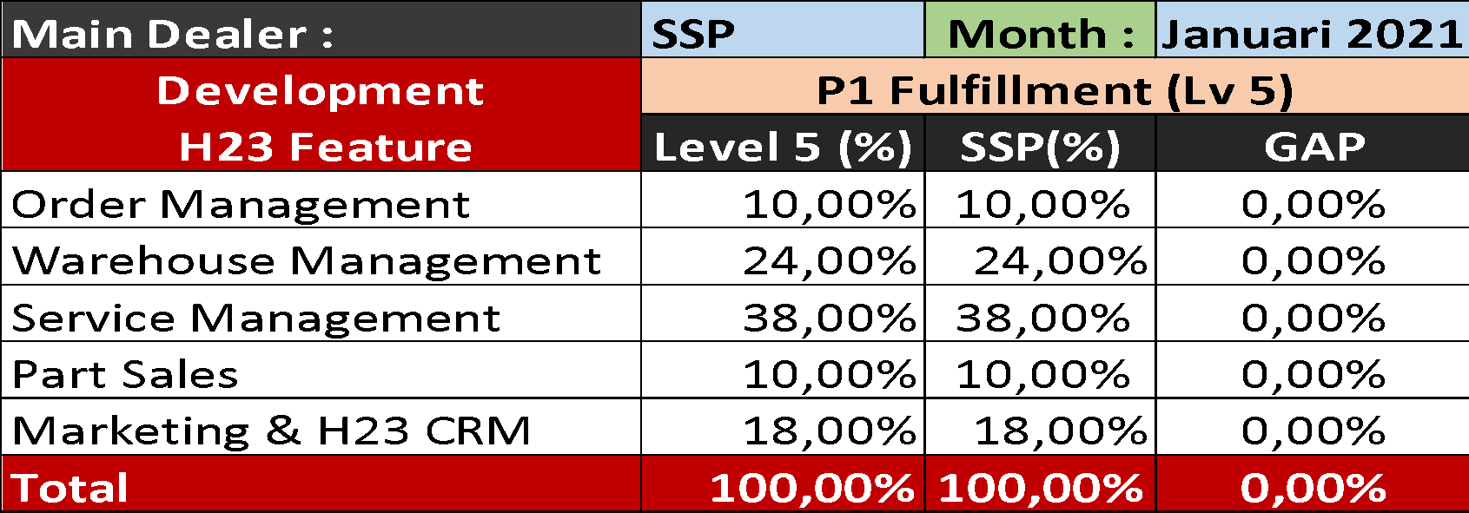
Update Development H23
Development seluruh feature NMS H23 sudah mencapai 100% per W4 Mei 2020 dan sudah memasuki fase Deployment

Slide 6
ONE ON ONE NMS PROJECT
Development
Penetration Testing
Deployment
NMS Next Phase
NMS Utilization & MD Strategy
MD Infrastructure
.
Dealer Group Integration
Benefit Measurement
Service Concept
CRM

Slide 7
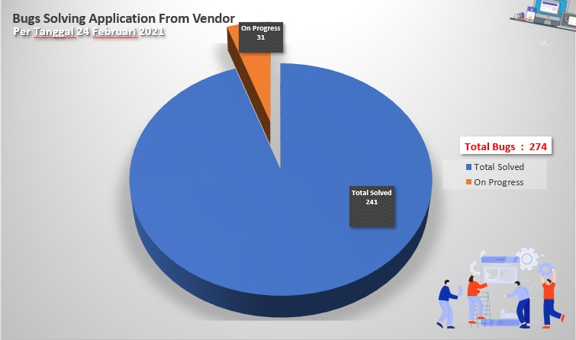
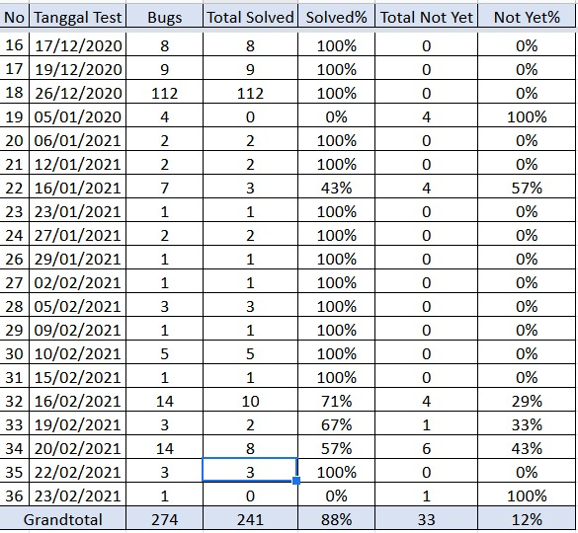
Stabilisasi Development
7%
93%

Slide 8
ONE ON ONE NMS PROJECT
Development
Penetration Testing
Deployment
NMS Next Phase
NMS Utilization & MD Strategy
MD Infrastructure
.
Dealer Group Integration
Benefit Measurement
Service Concept
CRM

Slide 9
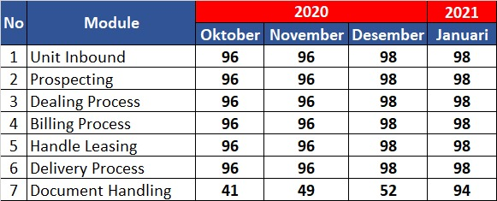
NMS Utilization
Module H1
Utilisasi NMS H1 untuk 6 (enam) features sudah mencapai 98% di bulan Desember 2020 tinggal 1 (satu) dealer lagi yaitu Surya Mandala Tempino yang sedang proses relokasi dan sementara waktu tidak beroperasional sehingga utilisasi belum dapat berjalan. Untuk feature document handling mengalami peningkatan drastis di bulan Januari 2021 dan mencapai 94% melalui peningkatan eskalasi monitoring termasuk aktifitas Push and Pull terhadap utilisasi di sisa dealer yang belum aktif.

Slide 10

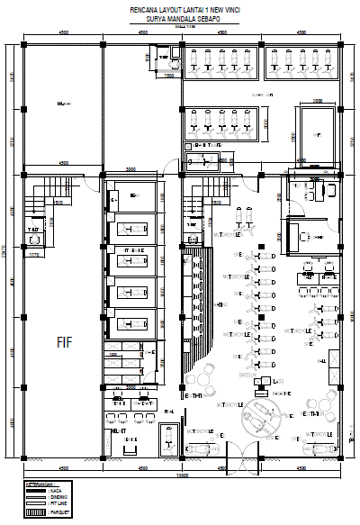
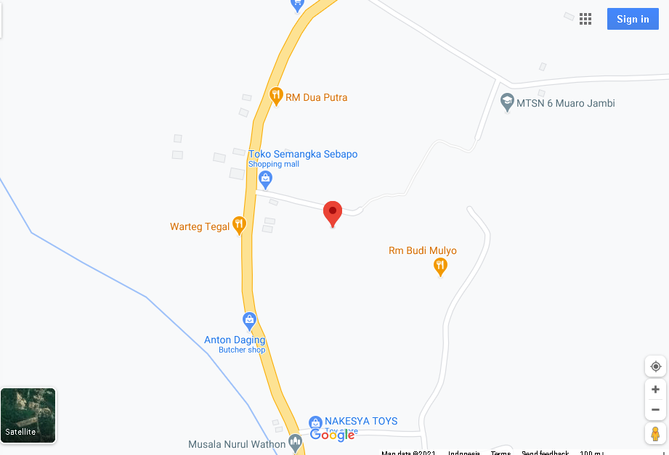
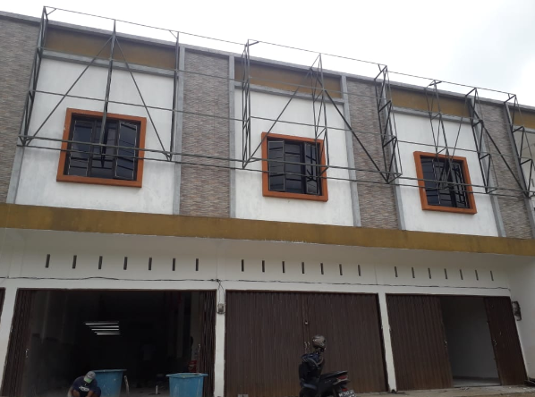
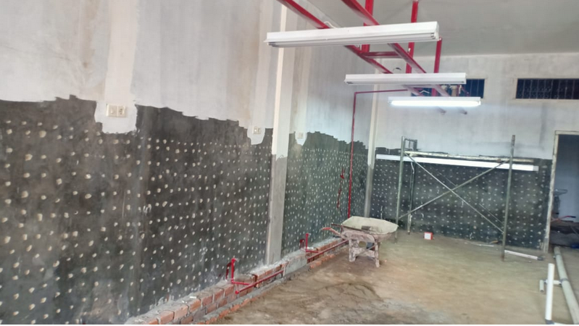
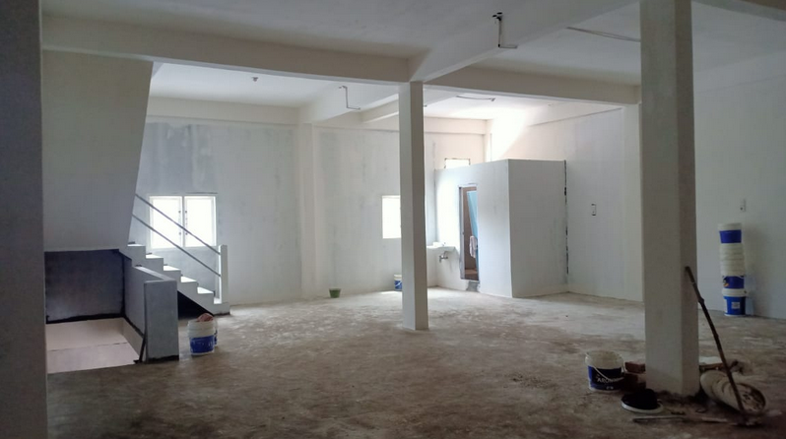
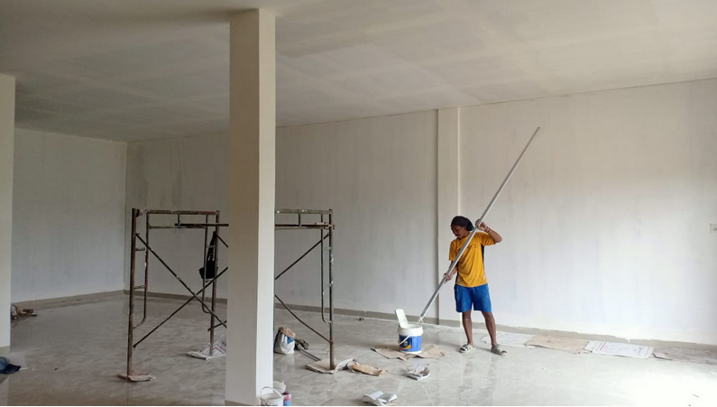
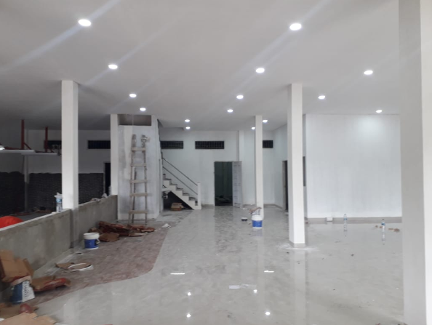
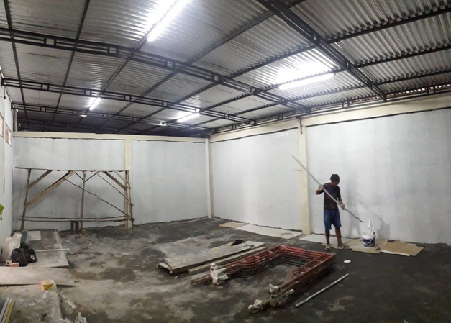
Relokasi Dealer SM Tempino
Data Penjualan Surya Mandala Tempino 2020
Dealer Surya Mandala Tempino sedang dalam proses relokasi dealer sehingga belum dapat melakukan utilisasi semua feature NMS H1 karena faktor operasional
Progress terakhir renovasi bangunan Dealer
Lokasi Dealer
Tampak Depan
Lay out Dealer
Area AHASS
Area Showroom
Gudang Unit

Slide 11
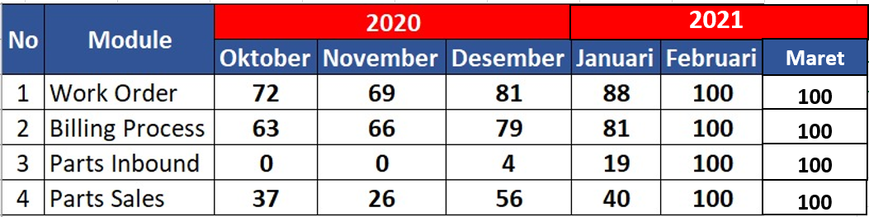
NMS Utilization
Module H23
Utilisasi NMS H23 sudah tercapai 100% dari 4 modul yang ada

Slide 12
AHASS UTILIZATION
NMS Utilization

Slide 13
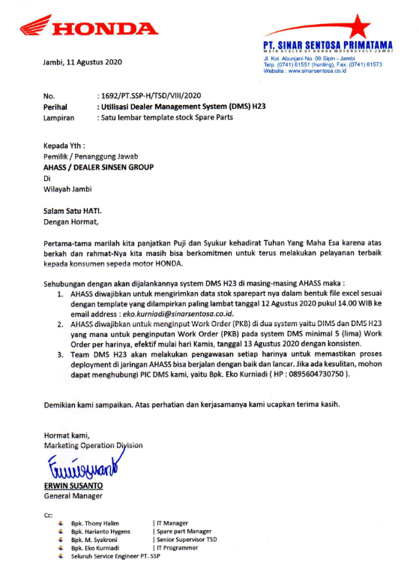
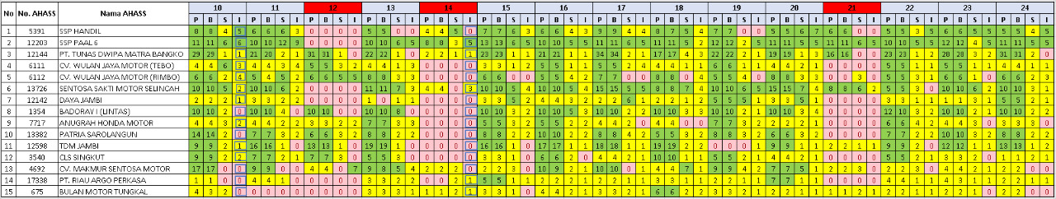
Highlight Strategy
HIGHLIGHT STRATEGY :
Melakukan training dan pendampingan terhadap network AHASS yang bermasalah dalam sumber daya manusia baik online untuk district yang di luar kota dan offline untuk district kota Jambi
Memonitor network AHASS melakukan utilisasi Parts Inbound (penerimaan spare parts) di system sampai minimal 85% sebagaimana form monitoring di bawah ini
Utilisasi NMS H23
Surat utilisasi ke AHASS

Slide 14
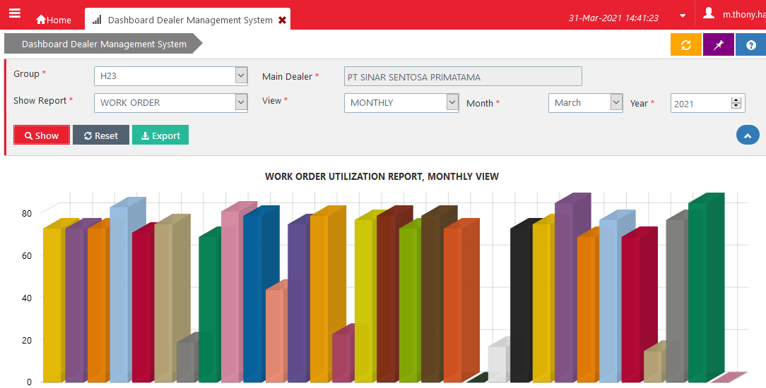
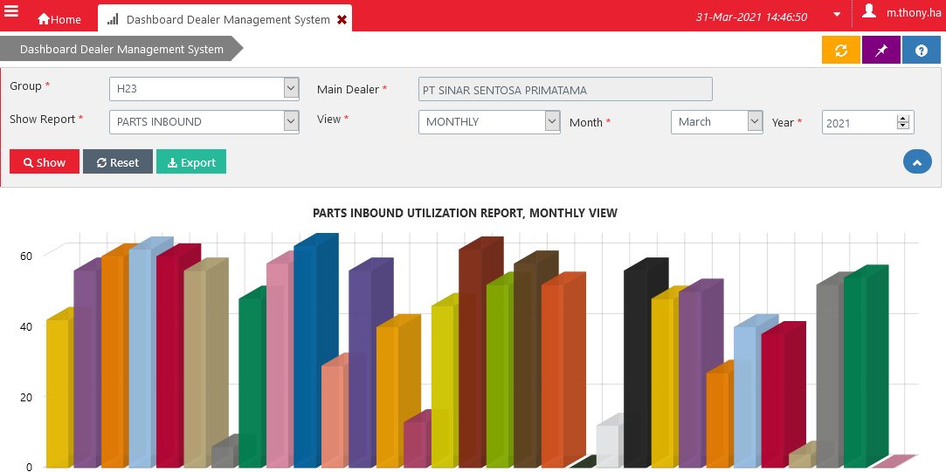
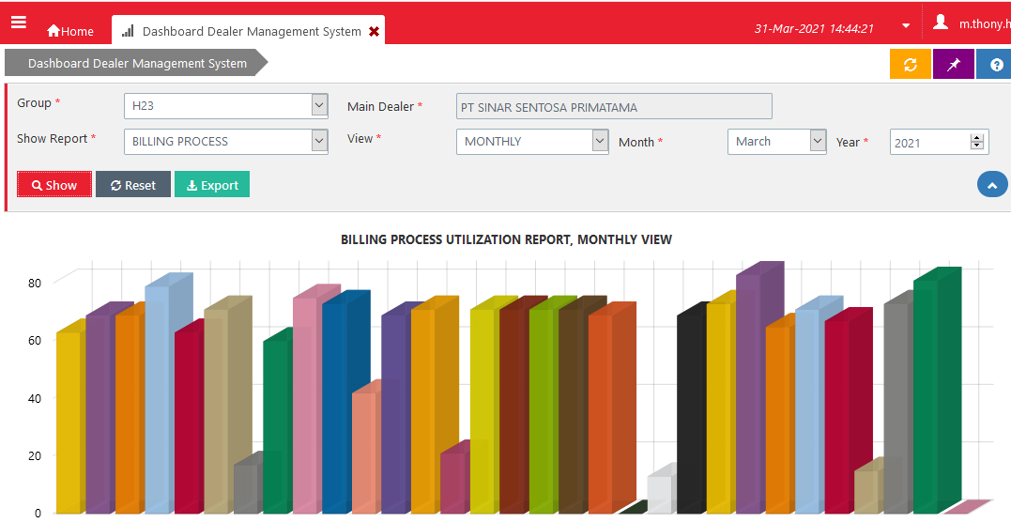
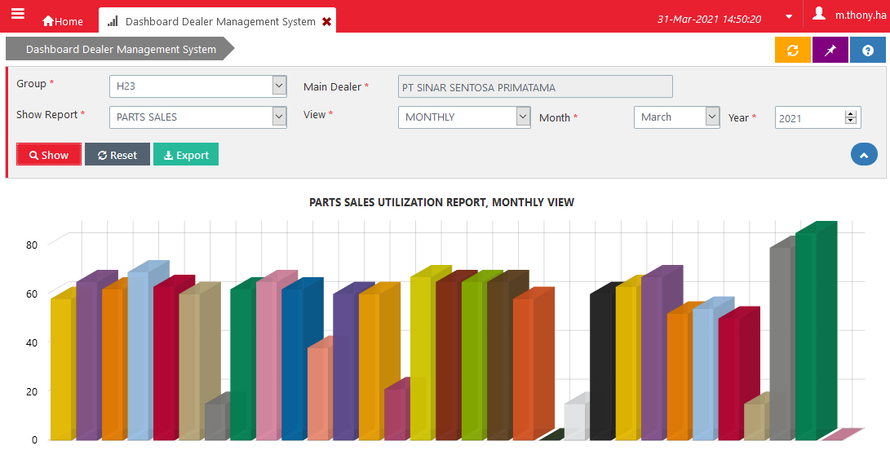
NMS Utilization Monitoring Tools
Dashboard Dealer Management System Portal PASTI AHM
Grafik Work Order Maret 2021
Grafik Parts Inbound Maret 2021
Grafik Billing Process Maret 2021
Grafik Parts Sales Maret 2021
Dashboard DMS Portal Pasti AHM dimanfaatkan optimal untuk memonitor pergerakan utilisasi NMS H23 di seluruh jaringan AHASS

Slide 15
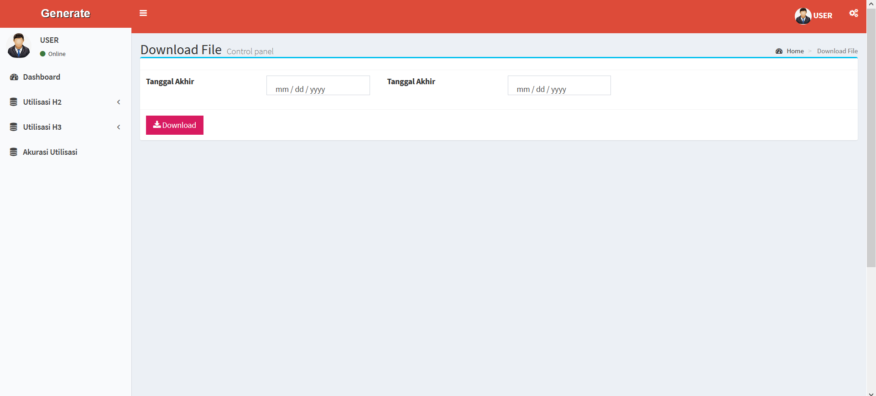
NMS Utilization Monitoring Tools By SinSen
Versi 1
Website Download File Utilisasi NMS H23
Website Download File Utilisasi NMS H23

Slide 16
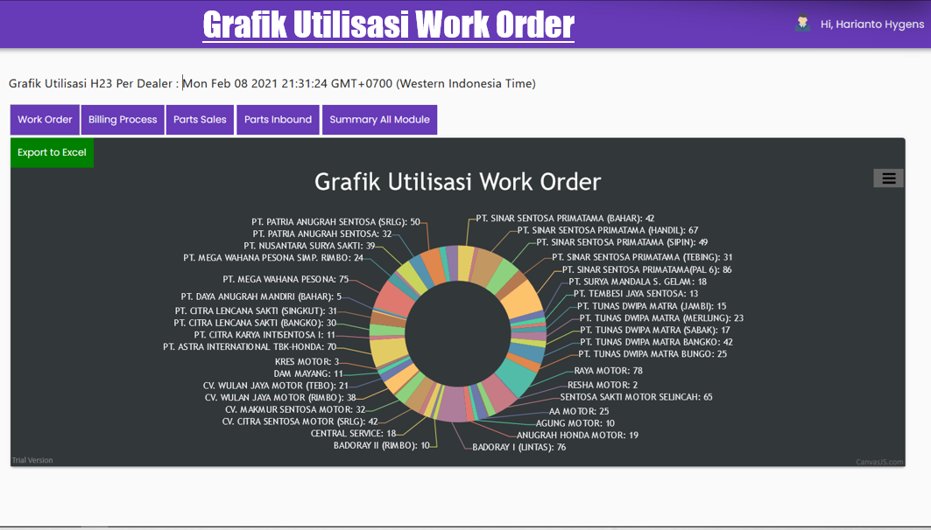
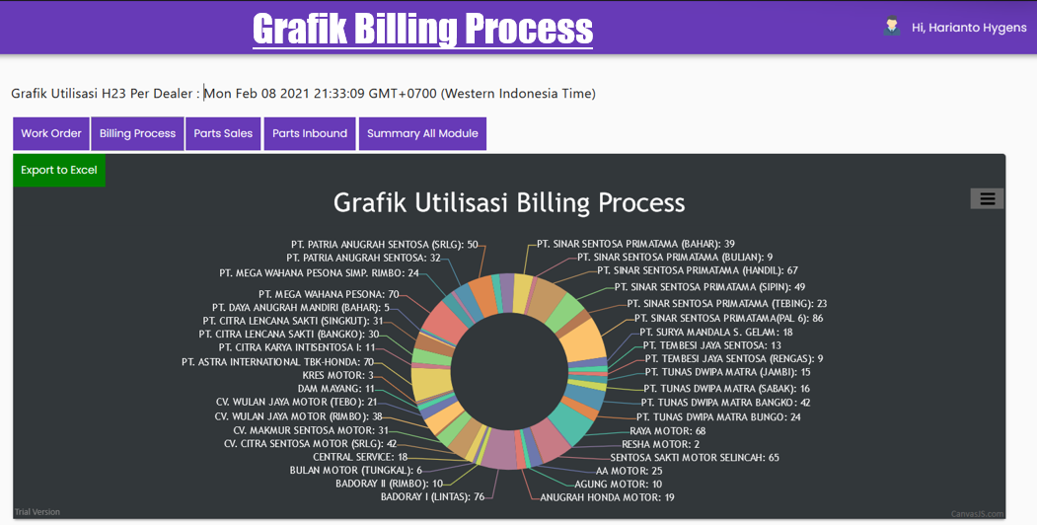
NMS Utilization Monitoring Tools
Versi 2
NMS Tools didevelop untuk monitor utilisasi NMS H23 setiap hari

Slide 17
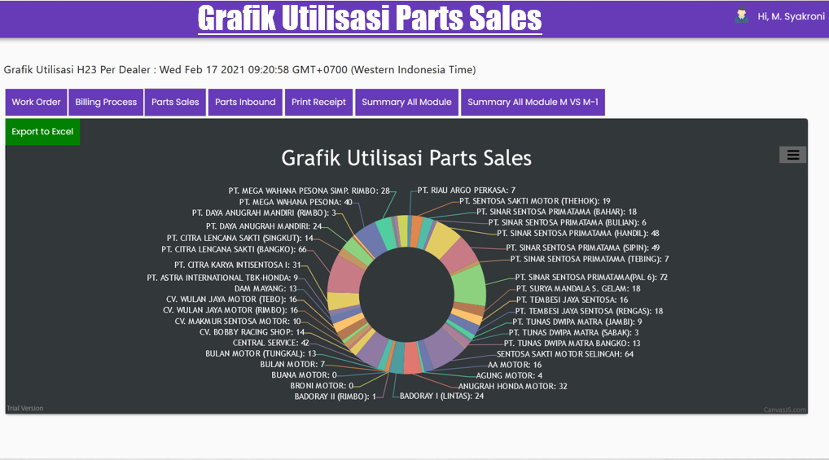
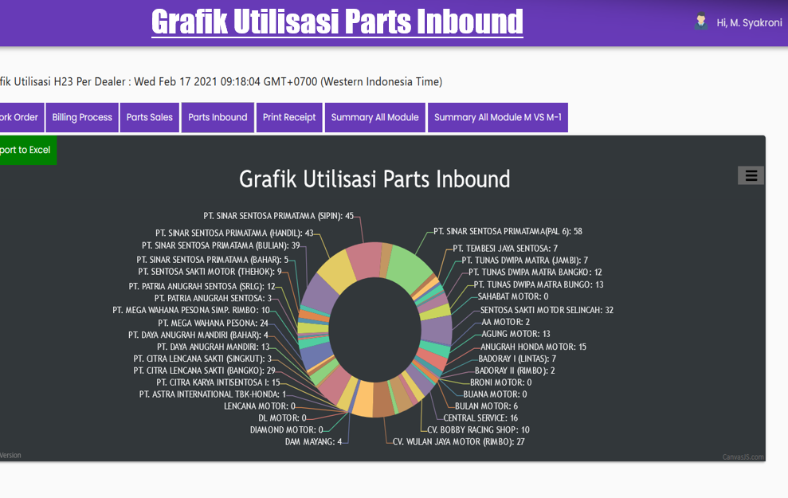
NMS Utilization Monitoring Tools
NMS Tools didevelop untuk monitor utilisasi NMS H23 setiap hari

Slide 18
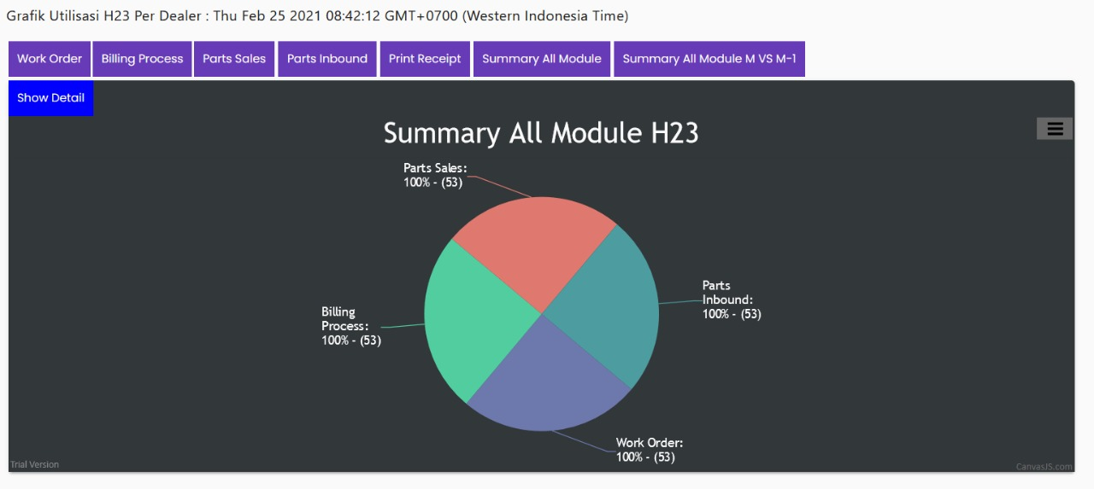
Summary All Module H23

Slide 19
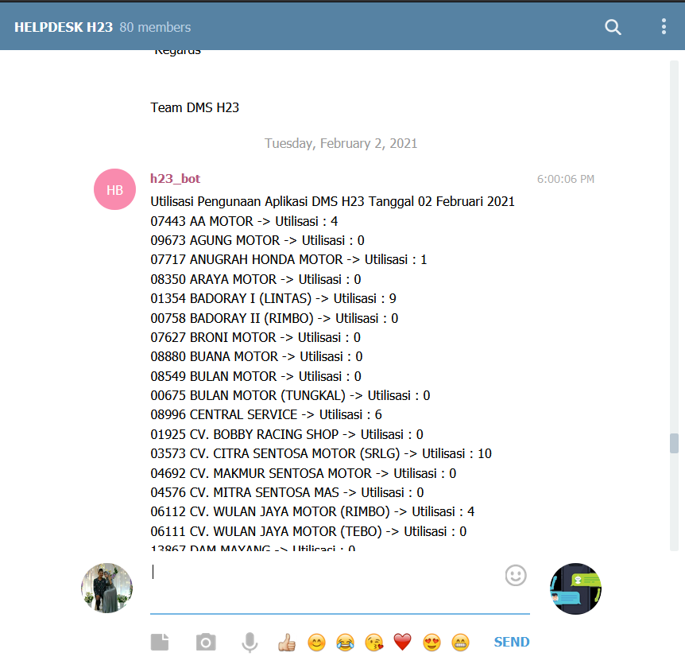
NMS Utilization Monitoring Tools
Versi 3
Recipient Group Telegram Help Desk H23 :
Fungsi Group Telegram Help Desk H23 :
01
Team IT MD SinSen
01
Sebagai Group Help Desk H23
02
Part Counter / Frontdesk AHASS
02
Sebagai Daily Monitoring Utilisasi H23 dimana dalam Group ini memiliki Bot Telegram, yang otomatis mengirimkan data utilisasi seluruh modul setiap harinya
03
Team TSD SE MD SinSen
04
Team Vendor (Monju)
05
PIC Dealer / Kabeng AHASS
06
Team Sparepart MD

Slide 20
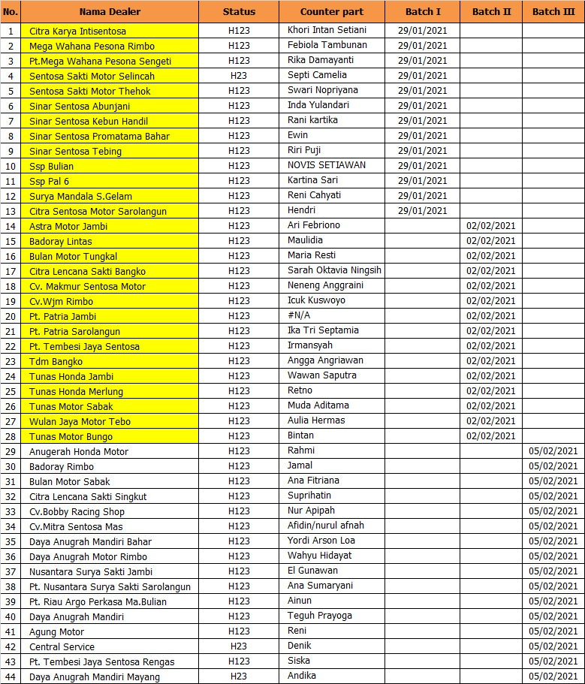
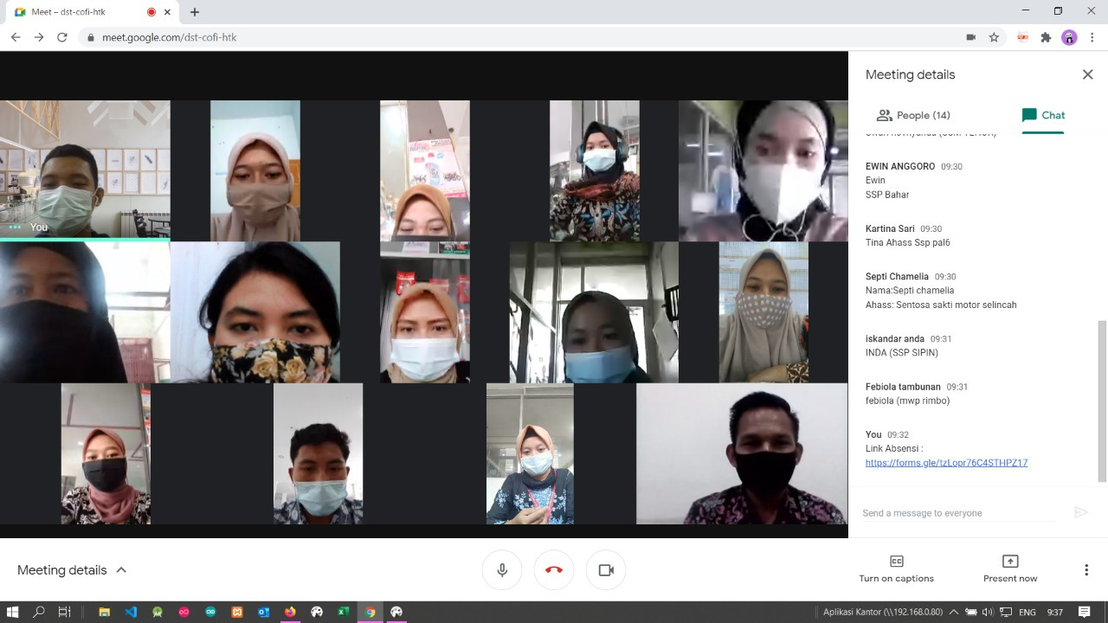
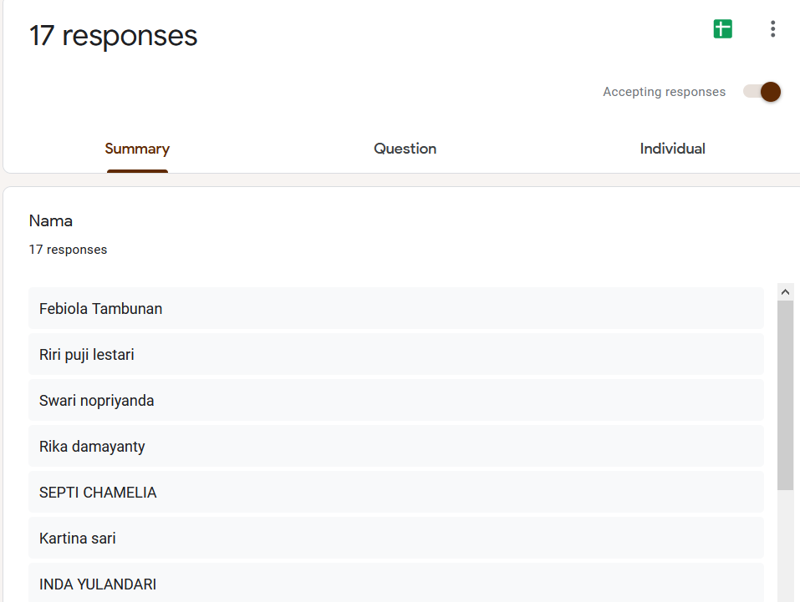
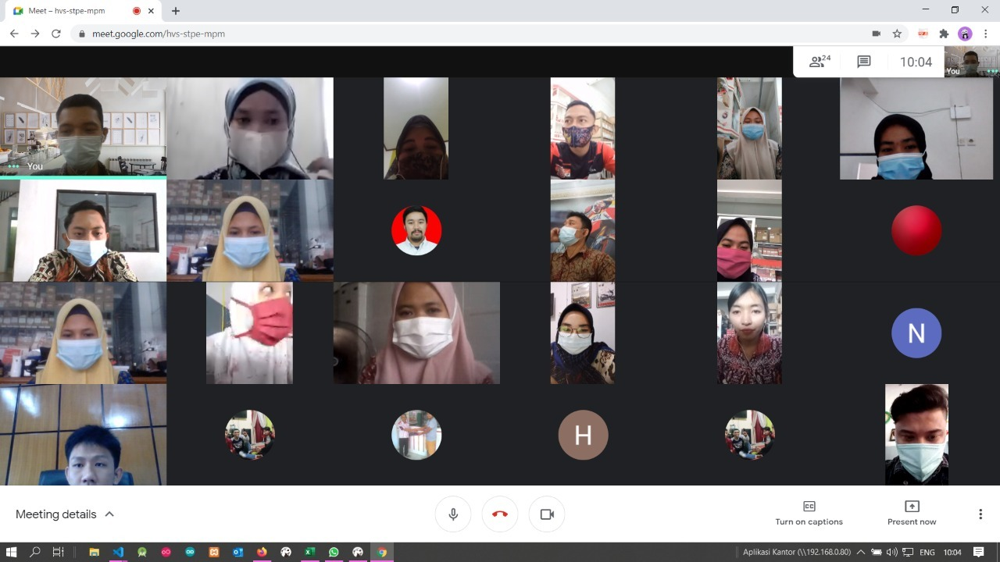
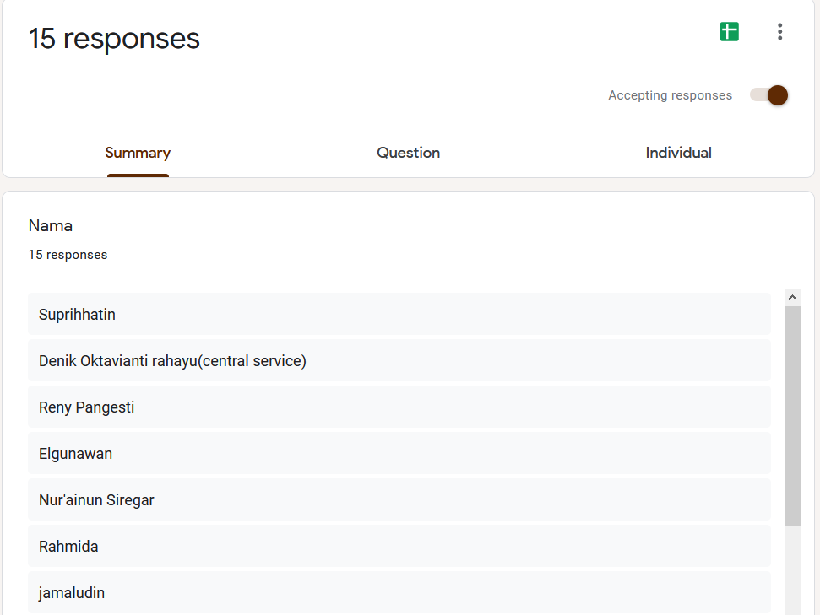
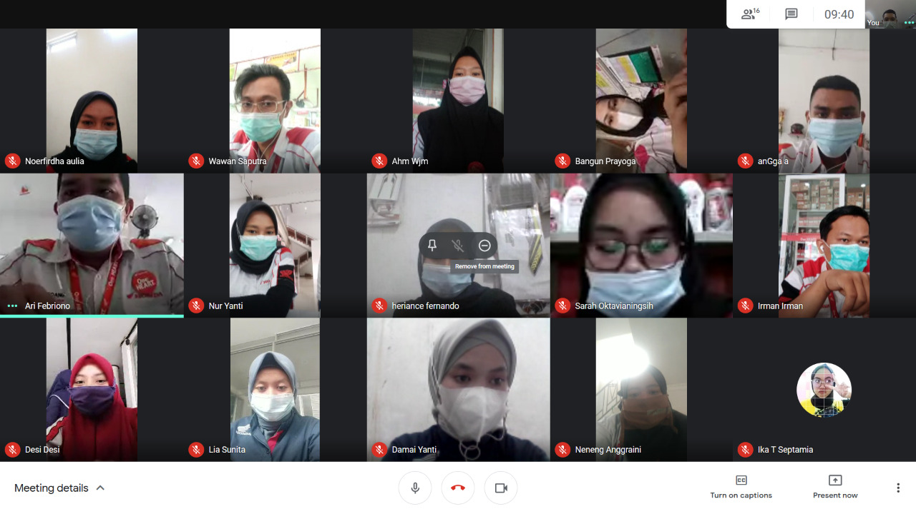
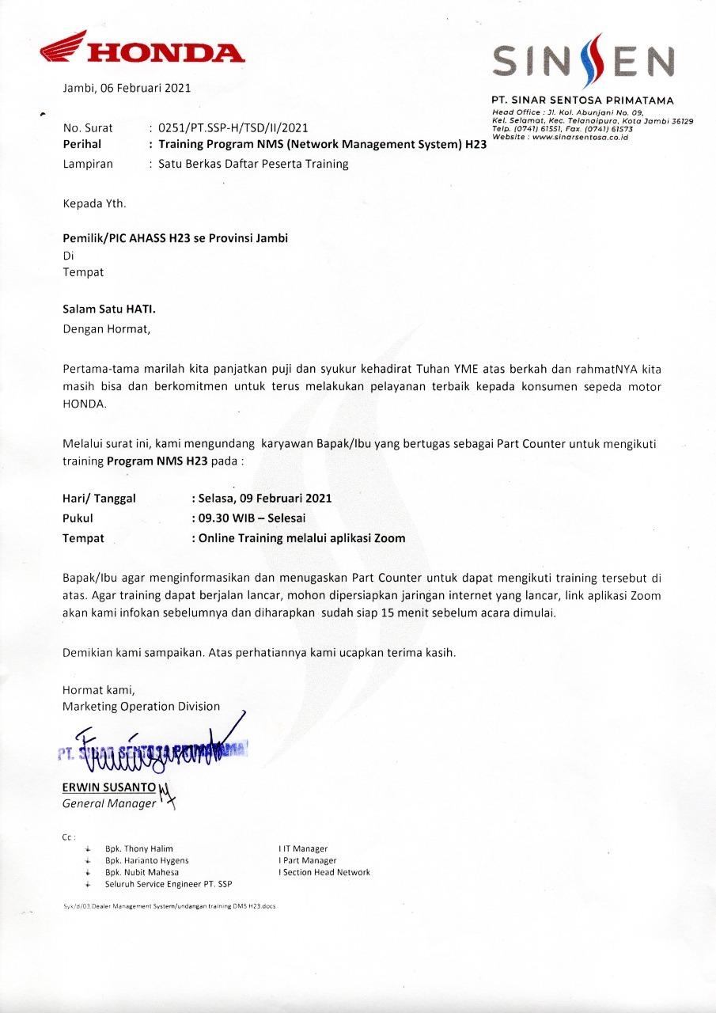
REFRESHMENT TRAINING NMS H23
Refreshment training NMS H23 telah dilakukan dalam 3 batch dari tgl 29 Jan s/d 5 Februari 2021 untuk meningkatkan utilisasi NMS H23 khususnya di modul Parts Sales dan Parts Inbound
Surat utilisasi ke AHASS

Slide 21
ONE ON ONE NMS PROJECT
Development
Penetration Testing
Deployment
NMS Next Phase
NMS Utilization & MD Strategy
MD Infrastructure
.
Dealer Group Integration
Benefit Measurement
Service Concept
CRM

Slide 22
DEALER GROUP INTEGRATION
7 Poin Integrasi DGI untuk H1
4 Poin Integrasi DGI pada H23
No | Point Integration H1 | Schema
1 | Prospect Activity | PULL
2 | Dealing Process | PULL
3 | Billing Process | PUSH
4 | Delivery Process | PULL
5 | Handle Leasing Requirement | PULL
6 | Manage Document Handling | PULL
7 | Unit Inbound | PULL
No | Point Integration H23 | Schema
1 | Work Order | PULL
2 | Billing Process | PUSH
3 | Parts Inbound | PULL
4 | Parts Sales | PULL
Fitur DGI yang digunakan oleh Dealer Group
(export-import/ web service)
Notes :
Push : DG HO melakukan Insert Data pada Server SinSen Pull : DG HO mengambil data di Server SinSen
No | Dealer Group | Features
1 | ASTRA MOTOR | Web Service
2 | PT. DAYA ANUGRAH MANDIRI | Web Service
3 | PT. TUNAS DWIPA MATRA | Web Service
4 | PT. PATRIA ANUGRAH SENTOSA | Web Service

Slide 23
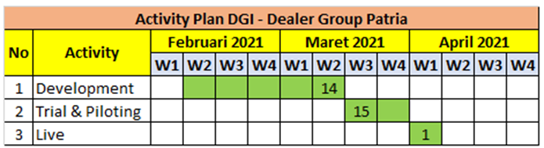
PROGRESS UPDATE DGI
Deadline Development Patria:
15 Maret 2021,
Sudah Terintegrated:
1 April 2021

Slide 24
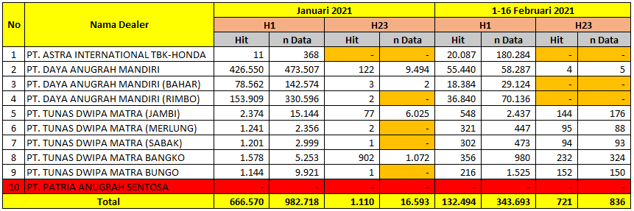
CAPTURE PROCESS INTEGRATED & TESTIMONY
Jumlah Permintaan Penarikan Data di Server SinSen terhadap Dealer Group dalam menggunakan fitur web service
Video / ScreenShot / Testimony Belum ada

Slide 25
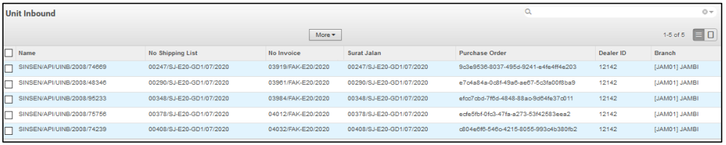
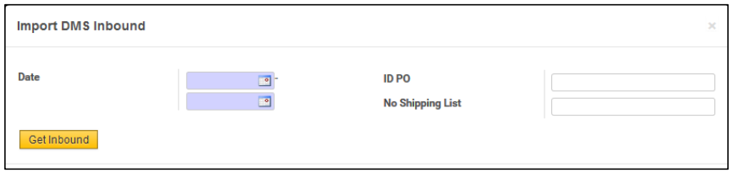
Screen Shot Process Integrasi DGI (Daya Group)
Contoh Data Unit Inbound di Sistem Daya (ODM)
Success Story Daya :
Team IT Daya sangat baik dan kooperatif
Sistem IT Daya sangat mendukung
Proses Integrasi menggunakan Schedular setiap 5 menit sekali
Infrastruktur Daya lebih memadai
Jaringan Internet lancar
Panel Manual Admin apabila data yang diinginkan gagal ditarik/ diintegrasikan

Slide 26
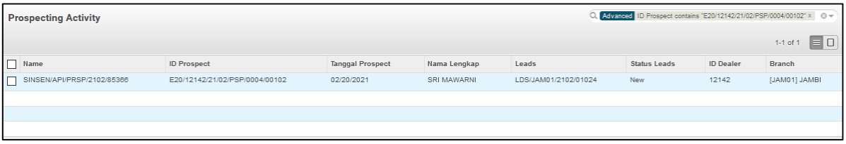
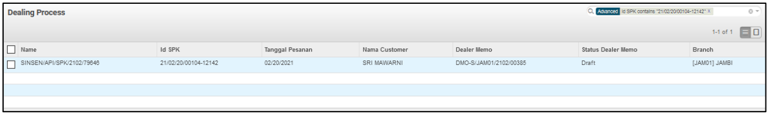
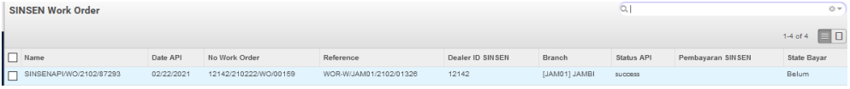
Screen Shot Process Integrasi DGI (Daya Group)
Tampilan Data Prospek di Sistem Daya Group (ODM)
Tampilan Data SPK di Sistem Daya Group (ODM)
Tampilan Data Work Order (WO) di Sistem Daya (ODM)

Slide 27
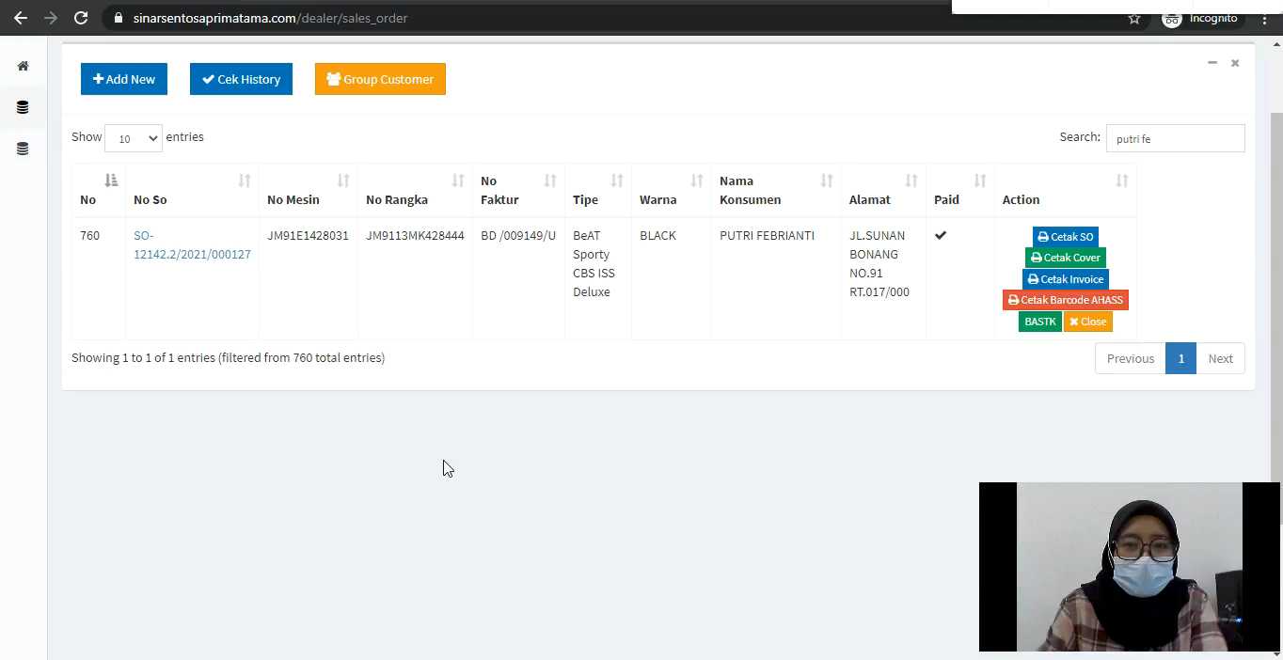
Video DGI
SEEDS dan ODM

Slide 28
ONE ON ONE NMS PROJECT
Development
Penetration Testing
Deployment
NMS Next Phase
NMS Utilization & MD Strategy
MD Infrastructure
.
Dealer Group Integration
Benefit Measurement
Service Concept
CRM

Slide 29
TIMELINE – SALES TOOLS (H1)
Januari - Maret
April - Mei
Juni - September
MAIN
DEALER
TESTING APLIKASI
SALES TOOLS H1
UAT & INTEGRATION TESTING NMS
PILOTING & DEPLOYMENT
Oktober – Desember
- 2022
POST GO LIVE & SUPPORT
DEALER
Maret – Mei
PENGADAAN DEVICES & INSTALASI APLIKASI

Slide 30
TIMELINE – SERVICE MANAGEMENT (H23)
Januari - Maret
Maret - Mei
Juni - Agustus
MAIN
DEALER
UAT & FIXING –
APLIKASI SERVICE MANAGEMENT
INTEGRATION TESTING NMS & SERVICE CONCEPT
PILOTING & DEPLOYMENT
September– Desember
- 2022
POST GO LIVE & SUPPORT
DEALER
Maret – Mei
PENGADAAN DEVICES & INSTALASI APLIKASI

Slide 31
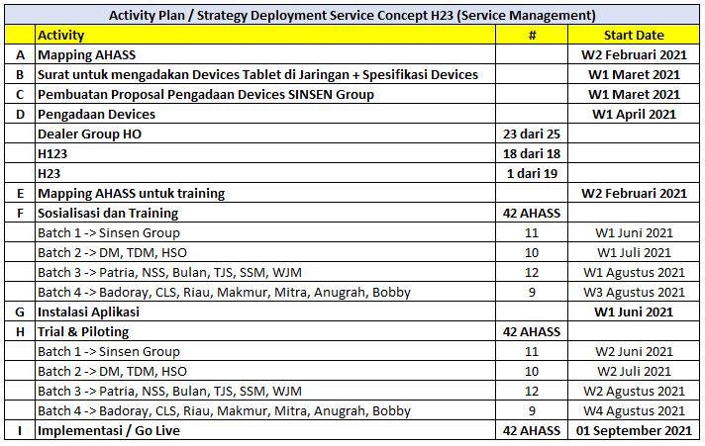
Activity Plan Deployment Service Concept – H23

Slide 32
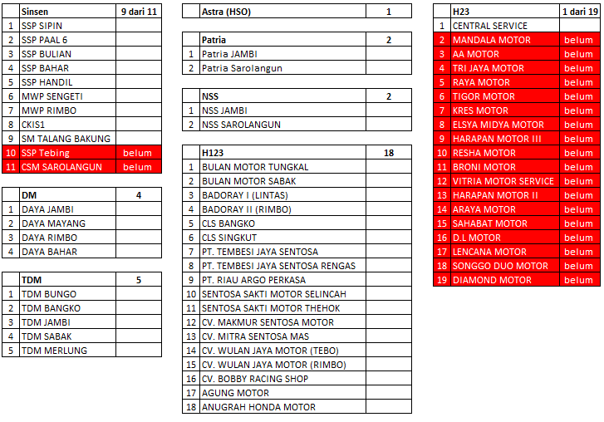


Detail mapping deployment AHASS - Service Concepts
Problem di 2 dealer dan di 18 AHASS tersebut dikarenakan tidak ada Service Advisor dedicated

Slide 33

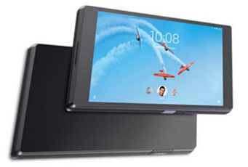

Standard of Device Specifications
Handphone
Tablets
Minimum OS: Android 7.0 - Nougat
Minimum Ukuran Layar: 7 Inch
Memory / Storage:
32 GB
Minimum OS: Android 7.0 - Nougat
>2000K
Minimum RAM:
2GB
Memory / Storage:
32 GB
Minimum RAM:
2GB
Bisa dikoneksikan dengan Wifi
Bisa dikoneksikan dengan Wifi
>1500K
POLICY
Penyiapan device seperti HP Android dan Tablets untuk keperluan implementasi DMS (Service Concepts) menjadi tanggung jawab dan beban dealer.

Slide 34
ONE ON ONE NMS PROJECT
Development
Penetration Testing
Deployment
NMS Next Phase
NMS Utilization & MD Strategy
MD Infrastructure
.
Dealer Group Integration
Benefit Measurement
Service Concept
CRM

Slide 35
Activity Plan & Timeline
Desember 2020
Januari 2021
Februari 2021
7 – 9 Desember
5- 7 Januari
8 – 10 Februari
MD Preparation
Report
Verification
10 – 11 Desember
8 – 22 Januari
5 Februari
Penetration Test
Remediation
Final Report
Black Box
Grey Box
White Box
Early Report
Critical Finding

Slide 36
FINDING BLACK BOX
Pengujian atau serangan yang dilakukan dari luar sistem dengan tools scanning
Findings Black Box Website Main Dealer
No | Risk | Problem | Description | Solved Description | Status
1 | High | Weak Credential | Akun login sangat lemah | Akun login credensial sudah dirubah | Done
2 | High | Directory listing enabled | List folder yang mudah diakses oleh public | Directory File sudah diberikan File Permission | Done
3 | High | Local File Download | List folder download yang mudah diakses public | difilter dengan File Permission | Done
Current Risk Level
Level | Risk | %
Critical | 0 | 0,00
High | 3 | 100,00
Medium | 0 | 0,00
Low | 0 | 0,00
Info | 0 | 0,00
TOTAL | 3 | 100%
Terdapat 3 temuan kategori Black Box dengan Current Risk Level High

Slide 37
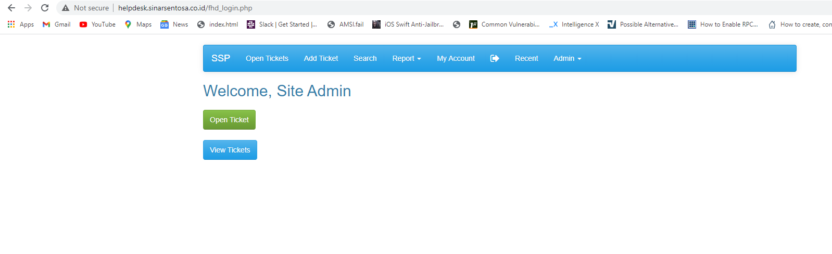
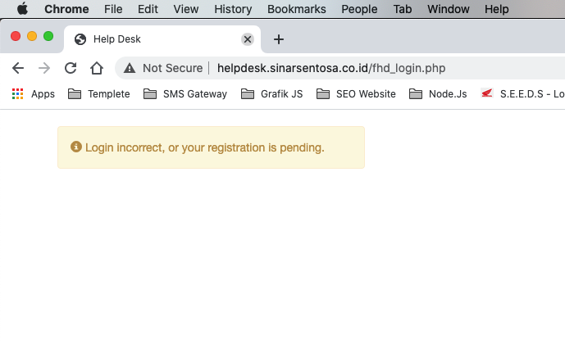
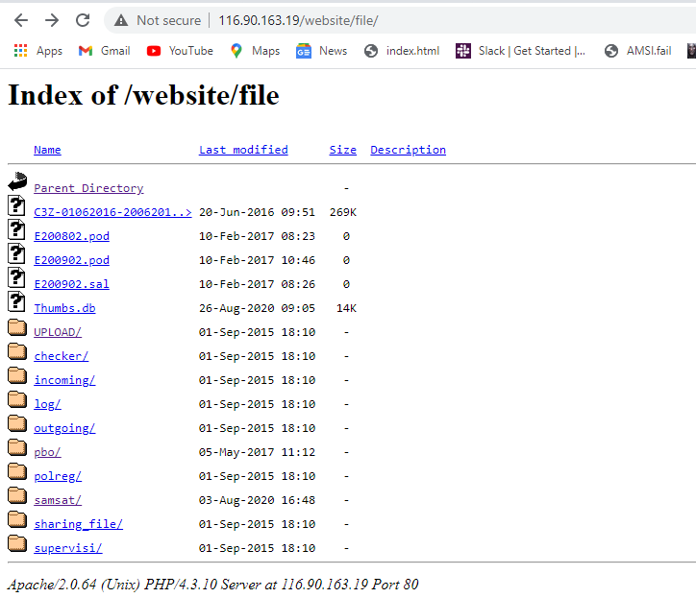
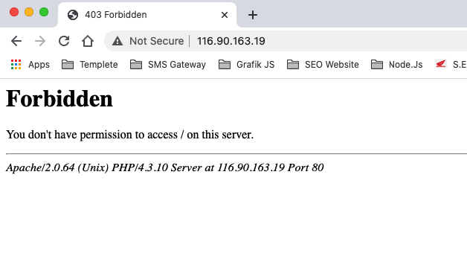
Screenshot Black Box
Weak Credential
Before
After
2. Directory listing enabled
Before
After

Slide 38
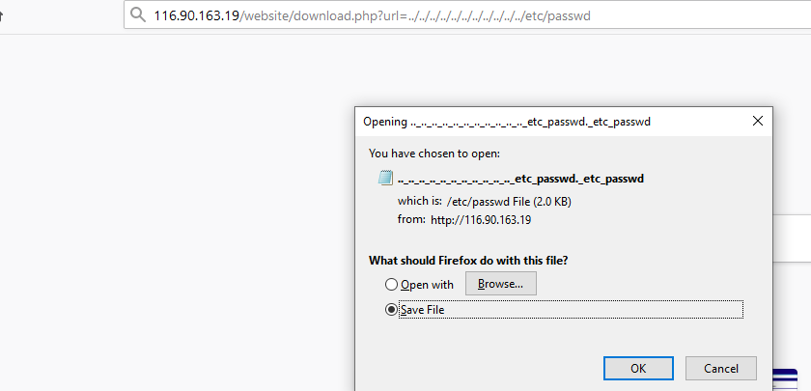
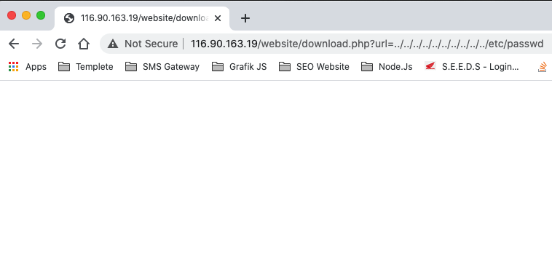
Screenshot Black Box
3. Local File Download
Before
After

Slide 39
FINDING GREY BOX
Pengujian atau serangan yang dilakukan dari dalam sistem sebagai pengguna setelah melalui authentifikasi login.
Findings Grey Box Website Main Dealer
No | Risk | Problem | Description | Solved Description | Status
1 | Critical | Authenticated SQL Injection | Serangan ke system database | diberikan filter protect terhadap serangan Sql Injection di setiap baris code input | Done
2 | Medium | Stored Cross Site Scripting (XSS) | Menyisipkan kode javascript ke inputan form | disetiap echo / cetak data dari database, di berikan fungsi tertentu untuk mengabaikan script javascript | Done
3 | Medium | Directory Listing Enabled | List folder yang mudah diakses oleh public | memberikan index file di setiap directory | Done
4 | Medium | File Error Log Disclosure | File Log error yang mudah diakses public | mendisable log disclosure | Done
5 | Medium | Insecure Error Handling | Fitur menampilkan error sistem | mendisable error handling | Done
6 | Medium | PHPinfo Disclosure | file phpinfo yang mengandung informasi mengenai PHP yang ada pada server | mendisable file phpinfo | Done
7 | Low | Weak Password Policy | kebijakan password policy yang mudah ditebak | memberikan fitur notification user untuk update password secara berkala dengan password yang mengandung karakter, angka dan huruf beserta huruf besar dan kecil. jika tidak segera update, sistem tidak bisa diakses | Done
Current Risk Level
Level | Risk | %
Critical | 1 | 14,29
High | 0 | 0,00
Medium | 5 | 71,43
Low | 1 | 14,29
Info | 0 | 0,00
TOTAL | 7 | 100%

Slide 40




Screenshot Grey Box
Authenticated SQL Injection
Before
After
2. Stored Cross Site Scripting (XSS)
Before
After

Slide 41




Screenshot Grey Box
3. Directory Listing Enabled
Before
After
4. File Error Log Disclosure
Before
After

Slide 42




Screenshot Grey Box
5. Insecure Error Handling
Before
After
6. PHPinfo Disclosure
Before
After

Slide 43


Screenshot Grey Box
7. Weak Password Policy
Before
After

Slide 44
ONE ON ONE NMS PROJECT
Development
Penetration Testing
Deployment
NMS Next Phase
NMS Utilization & MD Strategy
MD Infrastructure
.
Dealer Group Integration
Benefit Measurement
Service Concept
CRM

Slide 45



NMS NEXT PHASE
Timeline NMS Next Phase H1
Timeline NMS Next Phase H23
Phase NMS H23 sudah selesai di akhir bulan November 2020

Slide 46


NMS NEXT PHASE H23
PUD Notification
Service Execution

Slide 47
ONE ON ONE NMS PROJECT
Development
Penetration Testing
Deployment
NMS Next Phase
NMS Utilization & MD Strategy
MD Infrastructure
.
Dealer Group Integration
Benefit Measurement
Service Concept
CRM

Slide 48



Licensi Windows
TIMELINE PROJECT MAIN DEALER IT INFRASTRUCTURE
1. Server Cloud Development
& Test harus dimiliki
5. Redundansi perangkat critical
6. Sistem Monitoring untuk Infrastruktur
(Network, Server dan Database)
2020
2. Cloud Provider Quality
7. People Competencies(Server, Network,
Database, Peripheral** & Security)
3. Cloud Backup
4. Test Restore
8. Keamanan modem & Pembatasan/Pemisahan
Akses Wifi sesuai kebutuhan bisnis (Dealer)
2021
OS PC NB berlicense (Windows) atau
OS PC NB open source (Linux)
2. Finalisasi IT Policy, CTI & SLA
Kebijakan Perencanaan dan Organisasi Informasi Teknologi
Kebijakan Informasi Teknologi

Slide 49
ONE ON ONE NMS PROJECT
Development
Penetration Testing
Deployment
NMS Next Phase
NMS Utilization & MD Strategy
MD Infrastructure
.
Dealer Group Integration
Benefit Measurement
Service Concept
CRM

Slide 50
Measurement H1
 | PIC CRM | Sales Admin | Coordinator | CRM Admin | Cashier | Sales Counter | PDI man
Before NMS (Menit) | 68 | 600 | 80 | 230 | 10248 | 33,5 | 40
After NMS (Menit) | 14 | 47,6 | 34,5 | 14 | 5821,5 | 23,5 | 23
GAP | 54 | 552,4 | 45,5 | 216 | 4426,5 | 10 | 17
% Eficiency | 79% | 92% | 57% | 94% | 43% | 30% | 43%

Slide 51
Measurement H23
 | SA | Frontdesk | Parts Counter | Cashier | CRM Admin
Before NMS (Menit) | 41 | 47 | 242 | 34 | 157
After NMS (Menit) | 6 | 17,7 | 49,2 | 10 | 138
GAP | 35 | 55,3 | 192,8 | 24 | 19
% Eficiency | 85% | 76% | 80% | 71% | 12%

Slide 52
ONE ON ONE NMS PROJECT
Development
Penetration Testing
Deployment
NMS Next Phase
NMS Utilization & MD Strategy
MD Infrastructure
.
Dealer Group Integration
Benefit Measurement
Service Concept
CRM

Slide 53


Slide 54


Slide 55


